Slide 1
CaaS
Cable as a Service
Overview, Critique and Innovation
Group IS2
CHAVVI NIHAL CHANDANI : 19316970
PARITOSH CHAUHAN : 19320006
GEORGE JOHN CHAVADY : 19305272
CHAO CHEN : 19310133
SNEHAL DEY : 19303333
ESMOND DOMINIC DSOUZA : 19317479

Slide 2
OVERVIEW
Using the Research Canvas

Slide 3
1. Research Question/Aim: To what extent can consumer-oriented and product matching mobile applications based on Linked Data, achieve high usability? Consumer-oriented: This project is focusing on general web users in the mass market. Product matching: Searching and browsing for related products.
2. Research Objectives Reviewing the state of the art in mobile Linked Data applications. Designing product matching mobile application for MyVolts. Implementation of mobile app prototype. Iterations based on the experiments, user interviews and consumer surveys. |  | 3. Approach/Method to achieve objectives OnTop - to get Linked Data dataset. Remote SPARQL server endpoint. Design Principles: Norman’s human-computer interaction (HCI) Constantine & Lockwood’s 6 user interface design principles Design methods: paper-prototyping and analysing use cases.
4. Evaluation Evaluation Methods: Lab-based experiments. Web-based questionnaires
5. Contribution Proved that Linked Data mobile applications will achieve high usability. The technical challenge: Real time search method and Reducing server interaction
The evaluation stage includes four iterative experiments:
Feedbacks from MyVolts’ participants.
Test and survey after implementation.
App experience v.s. Webpage.
Questionnaires for potential users.
Solving usability challenge:
Designing widgets.
Implementing input methods, and
Proper Feedback for unrechable networks.

Slide 4
CRITIQUE

Slide 5
The Title: Is the title clear and appropriate? | Title is clear but not appropriate.
The Abstract: Is the abstract specific, representative of the article, and in the correct form? | As there was no abstract explicitly mentioned, we have inferred that the opening of the thesis is considered the abstract.
The Introduction: Is the purpose of the article made clear in the introduction? Is the research question researchable ? | The introduction is relevant to the article. The author gets the reader acquainted with the basic terminologies sufficiently. However, the only drawback is the inclusion of methodology in the introduction which is generally not the structure of the thesis. Yes it is researchable.
The Literature Review: Does it reveal gaps in the knowledge which this research will fill? | No. As the researcher has not brought novelty to the field of mobile application based on Linked Data.
Notes:
The Title:
Reason : The topics does not specify that the paper is about User Experience.
It rather communicates that the paper is about a Mobile App Driven by Linked Data for Power Supply Information
The Introduction :
Reason : According to the survey from Yus and Pappachan, there were only 36 Linked Data mobile applications available until 2015 and there was none related to product matching. Therefore, it is timely to investigate how to make it easy for people to consume and discover useful information when applying Linked Data to the real mobile world.. Hence, it is a researchable topic.

Slide 6
The Aim: Does it have a clear idea what the study tried to achieve? | It provides clear idea on implementing a Mobile Application based on Linked Data with high usability.
The Research Design Is the method deemed reliable and valid? | Yes. The researcher has extensively worked on finding design patterns for search user interface.
Data Analysis Were the steps involved in the data analysis explained and strategies justified? Was the data analysis rigorous enough to sustantiate the claims? | The steps involved in data analysis were well explained but none of the strategies were justified. No. As the number of people considered for the evaluation were too less.
The Discussion How relevant and useful are the results to practice? | The outcomes of this research were good enough to be applied to the real world.
Notes:
The Research Design:
Reason : He has researched on Search Design Pattern by juxtaposing on the various aspects of the search design pattern.
He has compared the patterns with common terminologies.
The Discussion :
The researcher was able to convince the MyVolts to collaborate further with ADAPT center to create a full version of their application. (In Final Remarks)

Slide 7
Conclusion: Were there any suggestions for future research? | The research paper itself states that the experiments were not done on sufficient number of people. Hence, it should be considered for future work research.
Reference List or Bibliography Are all sources cited clearly and with full bibliographic details provided? | Dissertation was cited with a good amount of references.

Slide 8
INNOVATION

Slide 9
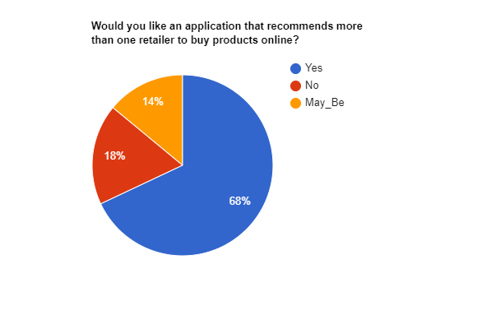
Innovation:
Selling and recommending power supplies from other retailers as well.
Testing :
Pivot : Not Required
Notes:
Testing Aspects:
Do you visit more than one store to check for prices of the same product ?
Would you like an application that recommends more than one retailer to buy products online?
Revenew: Pay per Click.

Slide 10
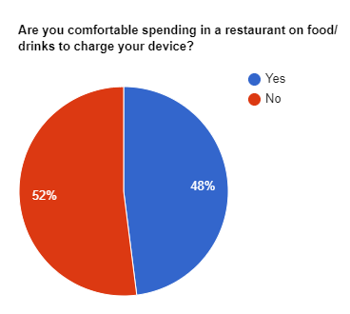
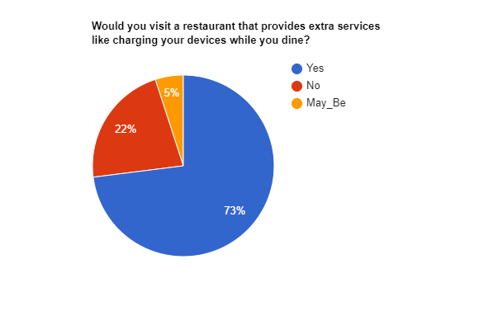
Innovation :
Partnering with cafes and restaurants to supply charging solutions to their customers. In turn restaurants are asking their customers to buy items from the them in order to charge their device.
Testing :
Pivot : As per market research, we decided that we will provide the users with 2 options:
Buy food/drinks from the restaurant and get free charging.
Pay for charging the device on hourly basis to the restaurant.
Notes:
Testing Aspects:
1.Would you visit a restaurant that provides extra services like charging your devices while you dine?
2. Are you comfortable spending in a restaurant on food/drinks to charge your device?
For eg. We met one of the customer who was of the thought process that he will prefer purchasing the cheapest item from the restaurant and charge his device for free. But, when compared to the other users we saw that “Time” is value for rest.

Slide 11
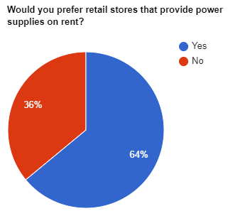
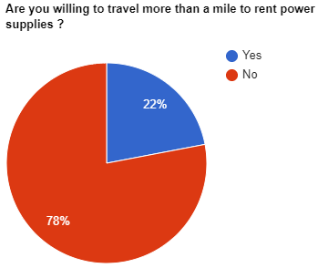
Innovation :
Renting from various nearby stores according to users current location.
Testing:
Pivot:
Renting it from nearby users, due to high availability and easier access ( lending and return )
Notes:
Testing Aspects:
Are you willing to travel more than a mile to rent power supplies?
Few said yes but , most of them would prefer to take it from their friends (e.g.,Students)
Shops have fixed closing time. Hence, people can rent it during those hours. Apart from that it will be an easy source of pocket money for students.
Revenue Model :-
Secuirtry deposit eg -$5 (refunded after returning cable.)
renting cost eg - $0.50
Revenue profit for MyVolts : The more wear and tear of the cable, the more purchase of cable from MyVolts app.

Slide 12
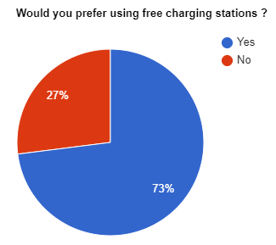
Innovation:
Providing users to find nearest Free Charging stations with interactive Kiosks.
Testing:
Pivot:
We strategically move the kiosks away from existing charging points(e.g., partner restaurants) to places like railway station, tourists spots, etc.
Notes:
Testing Aspects:
Most of the regular customers were interested in the idea of having free charging stations but as it would have affected the market of Restaurant Owners.
We planned on moving the Kiosks to tourists spots to broaden our reach as well as provide solutions to the most of them.
Example:
tourist places
bus stops
luas station
dart stations.

Slide 13
Thanks!
Team : CaaS

